Slide 1



FMM-Infrastructure eStore
alqama.hasnain@tatasteel.com
FMM-Infrastructure

Slide 2






PROBLEM STATEMENT
Manual Drift
Visibility Gap
Manual Checking
Paper registers are prone to physical damage, loss, and excessive paperwork in the department.
Zero real-time querying for stock levels leads to "stock-out" situations.
Tool holder tracking issues lead to unreturned equipmen. Daily manual checks are needed for due dates and expiration.

Slide 3
THE SOLUTION
The Digital Store
A centralized, cloud-accessible platform for issuing & tracking every asset in our stores.

Slide 4
IMPACT
Immediate Data Retrieval
By digitizing the store catalogue, employee no longer spend hours scouring shelves or registers. Location-based tracking ensures the right tool is found in seconds.
~80%
Immediate Issueance
By digitizing the store catalogue, employee no longer spend hours scouring shelves or registers. Location-based tracking ensures the right tool is found in seconds. This has resulted in a 90% reduction in the time taken to issue items.
Reduction in Search & Issuance Time
~99%
Decreased reliance on physical paperwork

Slide 5

OWNERSHIP & ACCOUNTABILITY
badge
P.No Mapping
Every issuance is strictly linked to a validated Personnel Number, ensuring absolute traceability for every asset.
update
Stock Restoration
Automatic stock updates upon return ensure the next shift has accurate counts and immediate availability.

Slide 6
COMPLIANCE
Calibration Tracking: Prevents the issuance of tools with expired inspection certificates/callibrations.
Safety Alerts: System flags items requiring immediate recalibration based on "Next Due Dates".
Traceability: Full digital trail for departmental safety audits and compliance reviews.

Slide 7







STREAMLINED CHECK-OUT WORKFLOW
ID Check
Stock Gate
Issuance
Real-time
Employee’s P.No validated against Issue Register.
System confirms availability before decrementing.
Digital record created with return deadline.
Live inventory counts updated.

Slide 8






ACCESS CONTROL
Encrypted Login
Role Separation
Authorised Access
Distinct permissions for 'Issuers' vs 'Admins' to prevent unauthorized transactions
Read-only access permitted for guests while write-access is locked.
Stateless JWT tokens ensure secure, protected workshop sessions.

Slide 9



FUTURE ROADMAP
Barcode Scanning
Alerts
Integration with handheld scanners for instant check-in/check-out.
Automated notifications (SMS, emails) to the concerned parties for overdue items.

Slide 10
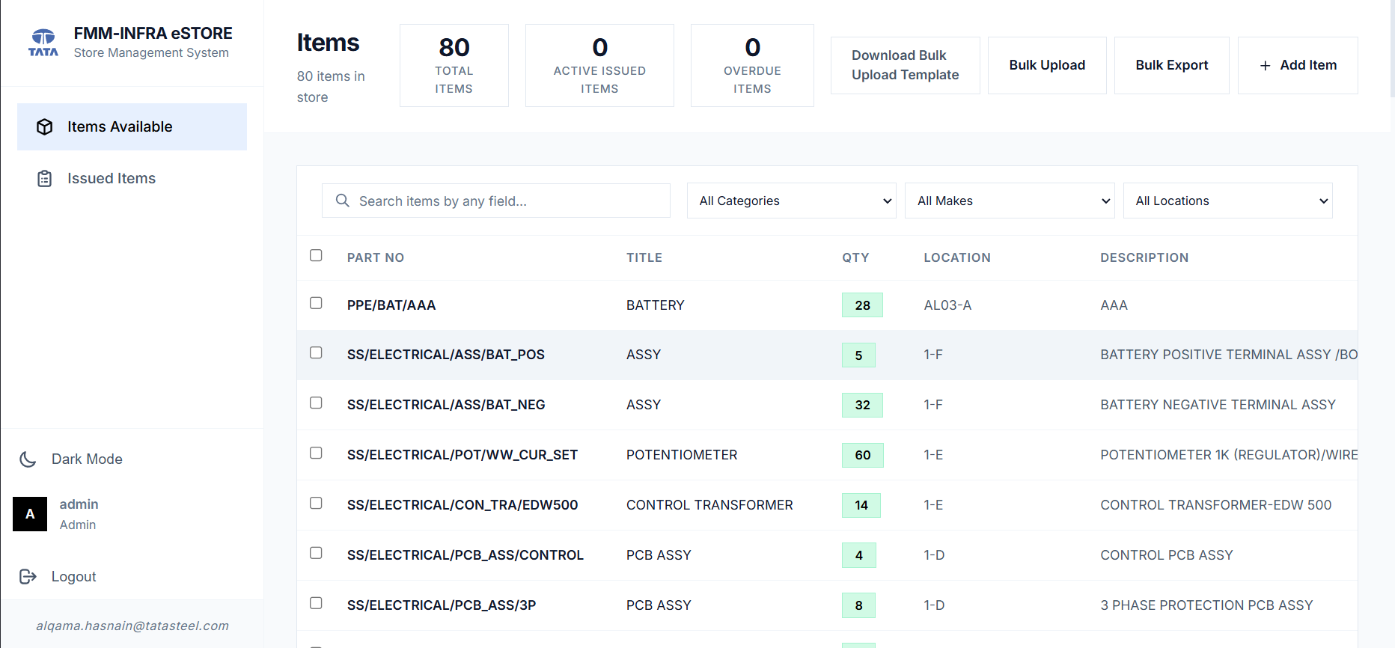

https://tsl-storemgmtsys-1.onrender.com/

Slide 11
THANKYOU

